Slide 1
Does glucose variability warm the vessels and organs?
7 ^{th} Seminary of LAREDIAB
13 ^{th} Congress of AMIWIT
SATURDAY 9 DECEMBER 2023
Dr Bensefia Amel
Service de médecine interne
CHU Tidjani Damerdji Tlemcen

Slide 2
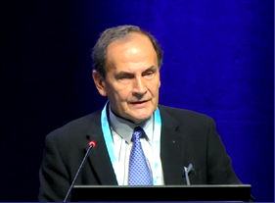
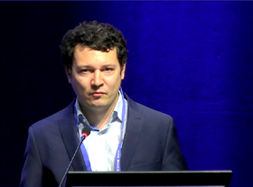
Does glucose variability warm the vessels and organs?

Slide 6
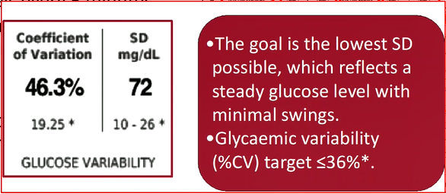

Slide 7
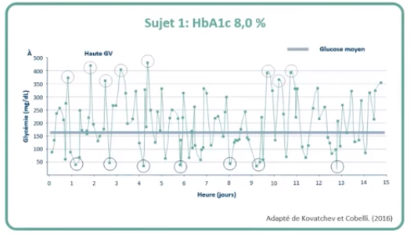
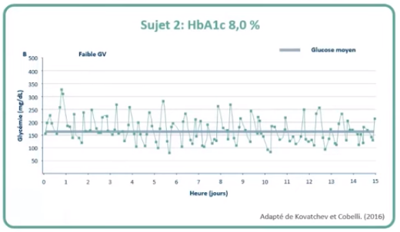
Kovatchev and cobelli,2016

Slide 10
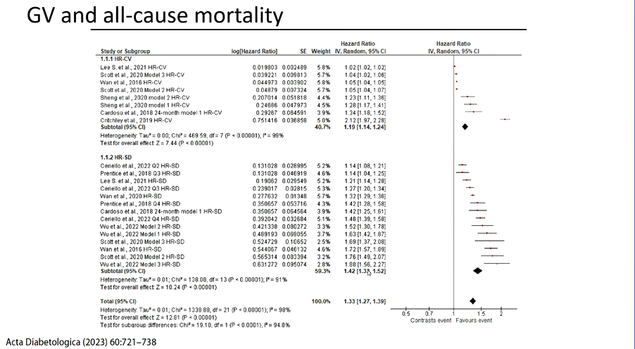

Slide 12
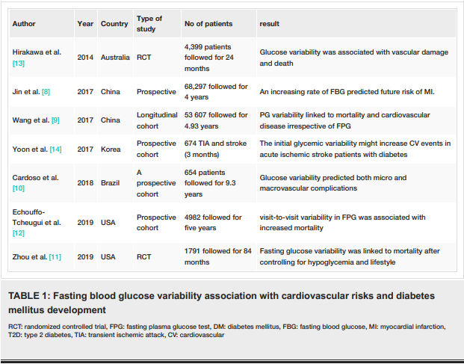

Slide 13
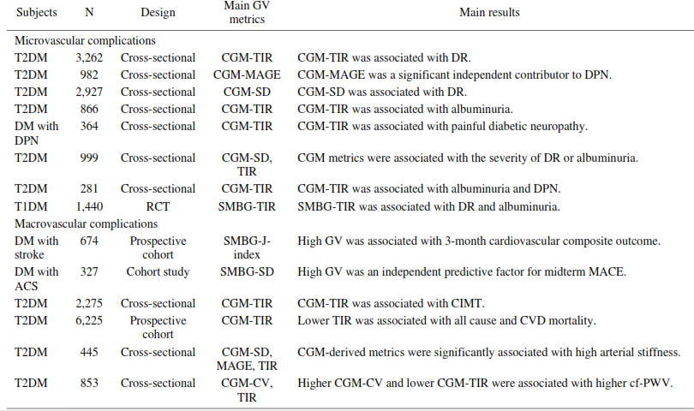

Slide 14
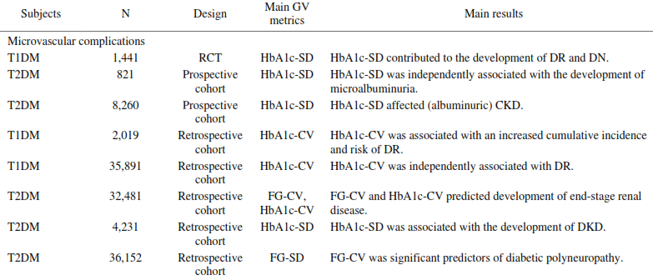
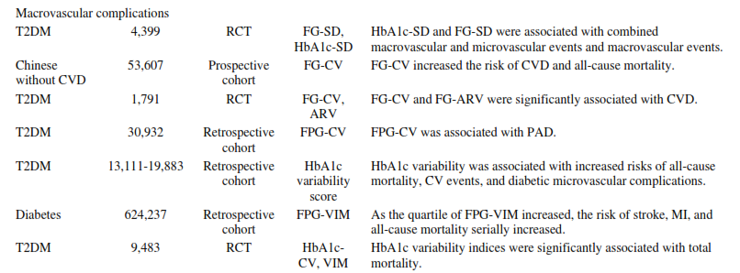

Slide 18
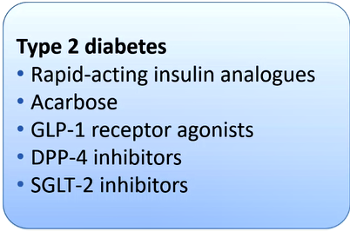

Slide 19
Does Glycemic variability exists in healthy subjects?

Slide 20
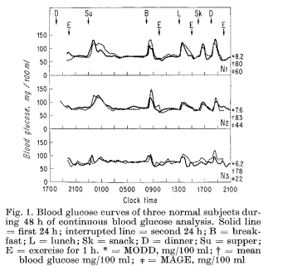
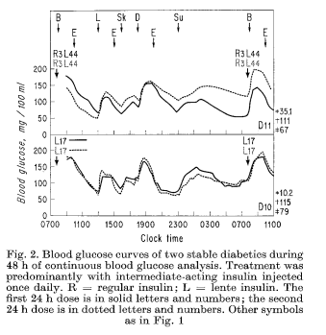
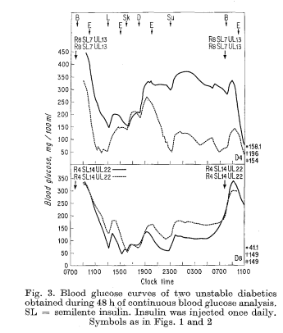

Slide 21
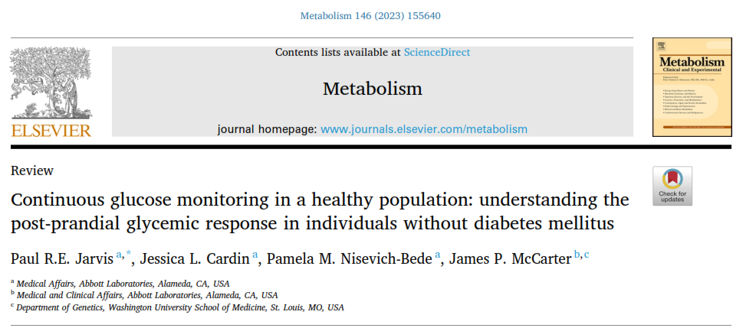

Slide 34
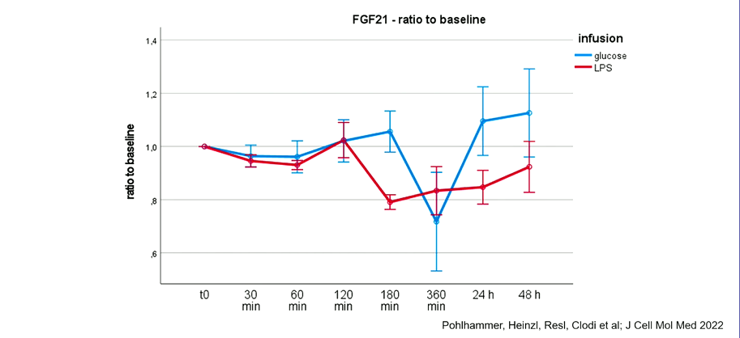

Slide 38
Key messages 1-in diabetic patients
Glycemic variability is a strong independant predictor of morbidity and mortality in patients with diabetes.
Experimental and clinical studies has associated GV with oxidative stress ,inflammation, and endothelial dysfunction,factors traditionnaly associated with the pathogenesis of macrovascular and microvascular diseases
Technology CGM is preferred to assess VG
To reduce GV selection of drugs targeting PPG and avoidance of hypogycemia

Slide 39
Key messages 2-in non diabetic patients
Glucose variability exists in metabollicaly healthy individuals
Many factors influencing glucose variability.
Glucose variability influences eating behavior and blood brain barrier.
Glucose excursions promote oxydatif stress and endothelia dysfunction.
Long term glucose variability predicts mortality.

