Slide 1
GLYCEMIA AND CARDIAC ARYTHMIAS IN TYPE 1 DIABETES
TROUBLES DE RYTHME CARDIAQUE
7 th CONGRESS of larediab
13 th CONGRESS OF AMIWIT
CH.ZEMIT, A.LOUNICI

Slide 2
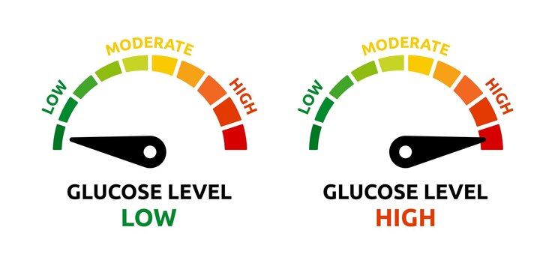
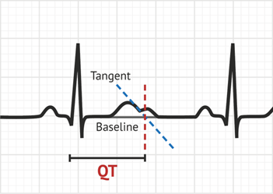
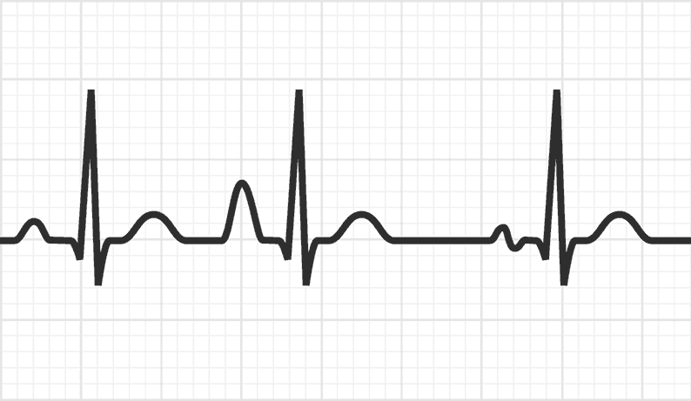
Extrasystoles ventriculaires
QT long
Extrasystoles atrials
QT long
hypoglycémie
hyperglycémie
CARDIAC ARYTHMIAS
INTRODUCTION

Slide 3
QT prolongation
Premature atrial beats
Premature ventricular beats
QT prolongation
HYPOGLICEMIA
HYPERGLYCEMIA
INTRODUCTION

Slide 4
QT prolongation
QT prolongation
Premature ventricular beats
Premature atrial beats
HYPOGLICEMIA
HYPERGLYCEMIA
INTRODUCTION

Slide 5
Inclusion criteria:
type 1 diabetes
age 18-80 years
hypoglycaemia or an episode of severe hypoglycaemia within the last year
one or more clinically relevant microvascular or macrovascular complication
exclusion criteria:
Patients with cardiac disease, such as arrhythmia, severe heart failure or structural heart disease
Individuals with implantable cardioverter-defibrillator or pacemaker
Patients with thyroid dysfonction
To investigate the impact of hypoglycaemia, hyperglycaemia and glycaemic variability on arrhythmia susceptibility in people with type 1 diabetes.
aims

Slide 6
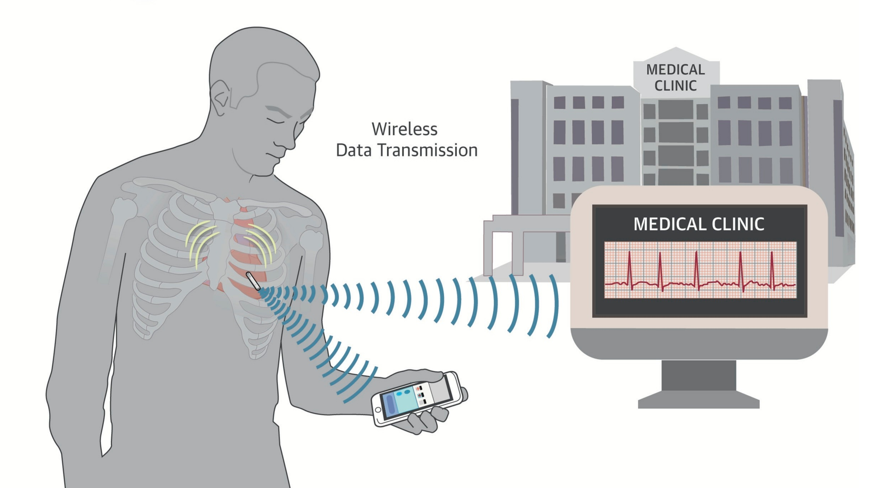
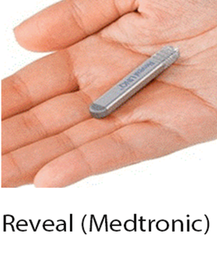
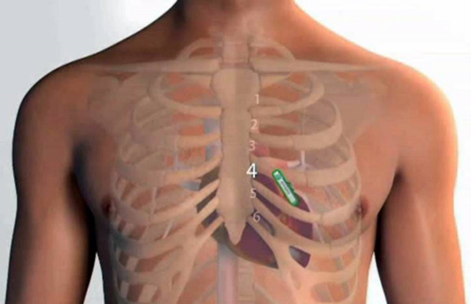
Inclusion criteria:
type 1 diabetes
age 18-80 years
hypoglycaemia or an episode of severe hypoglycaemia within the last year
one or more clinically relevant microvascular or macrovascular complication
exclusion criteria:
Patients with cardiac disease, such as arrhythmia, severe heart failure or structural heart disease
Individuals with implantable cardioverter-defibrillator or pacemaker
Patients with thyroid dysfonction
MATERIALS AND METHODS

Slide 7
events of cardiac arrhythmia were analysed as a binary outcome (event vs. no event) and were summarized per daytime/night-time period and per hour.
STUDY DESIGN: a12-month prospective observational exploratory study
long-term cardiac monitoring (implantable loop recorder [ILR])
MATERIALS AND METHODS

Slide 8
STUDY DESIGN: a12-month prospective observational exploratory study
long-term cardiac monitoring (implantable loop recorder [ILR])
events of cardiac arrhythmia were analysed as a binary outcome (event vs. no event) and were summarized per daytime/night-time period and per hour.
MATERIALS AND METHODS

Slide 9
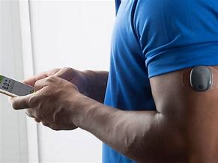
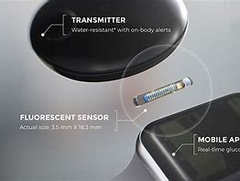
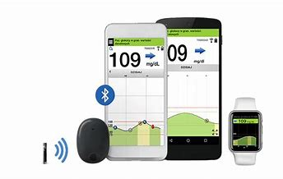
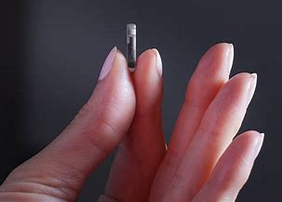
The following glycaemic predictors were summarized per hour for each participant:
time in hypoglycaemia (minutes)
time in hyperglycaemia (minutes)
occurrence of hypoglycaemia (binary)
occurrence of hyperglycaemia (binary)
SD and CV were summarized per daytime/night-time period.
STUDY DESIGN: a12-month prospective observational exploratory study
CONTINUE GLUCOSE MONITORING (CGM)
MATERIALS AND METHODS

Slide 10
STUDY DESIGN: a12-month prospective observational exploratory study
CONTINUE GLUCOSE MONITORING (CGM)
The following glycaemic predictors were summarized per hour for each participant:
time in hypoglycaemia (minutes)
time in hyperglycaemia (minutes)
occurrence of hypoglycaemia (binary)
occurrence of hyperglycaemia (binary)
SD and CV were summarized per daytime/night-time period.
MATERIALS AND METHODS

Slide 11
4 visits every 3 months
D0
Inclusion
Implantation of ILR
Implantation of
CGM
MATERIALS AND METHODS

Slide 12
4 visits every 3 months
12 mois
Mis a jours des bilans et de l’examen clinique
explantation du
CGM
Explantation de
l’holter
D0
Inclusion
Implantation of ILR
Implantation of
CGM
3,6 and 9 month
Up date and clinical examination
explantation of
CGM an it reamplantation
MATERIALS AND METHODS

Slide 13
4 visits every 3 months
3,6 and 9 month
Up date and clinical examination
explantation of
CGM an it reamplantation
12 month
Up date data and clinical examinations
explantation of
CGM
Explantation of
l’holter
D0
Inclusion
Implantation of ILR
Implantation of
CGM
MATERIALS AND METHODS

Slide 14
results

Slide 15
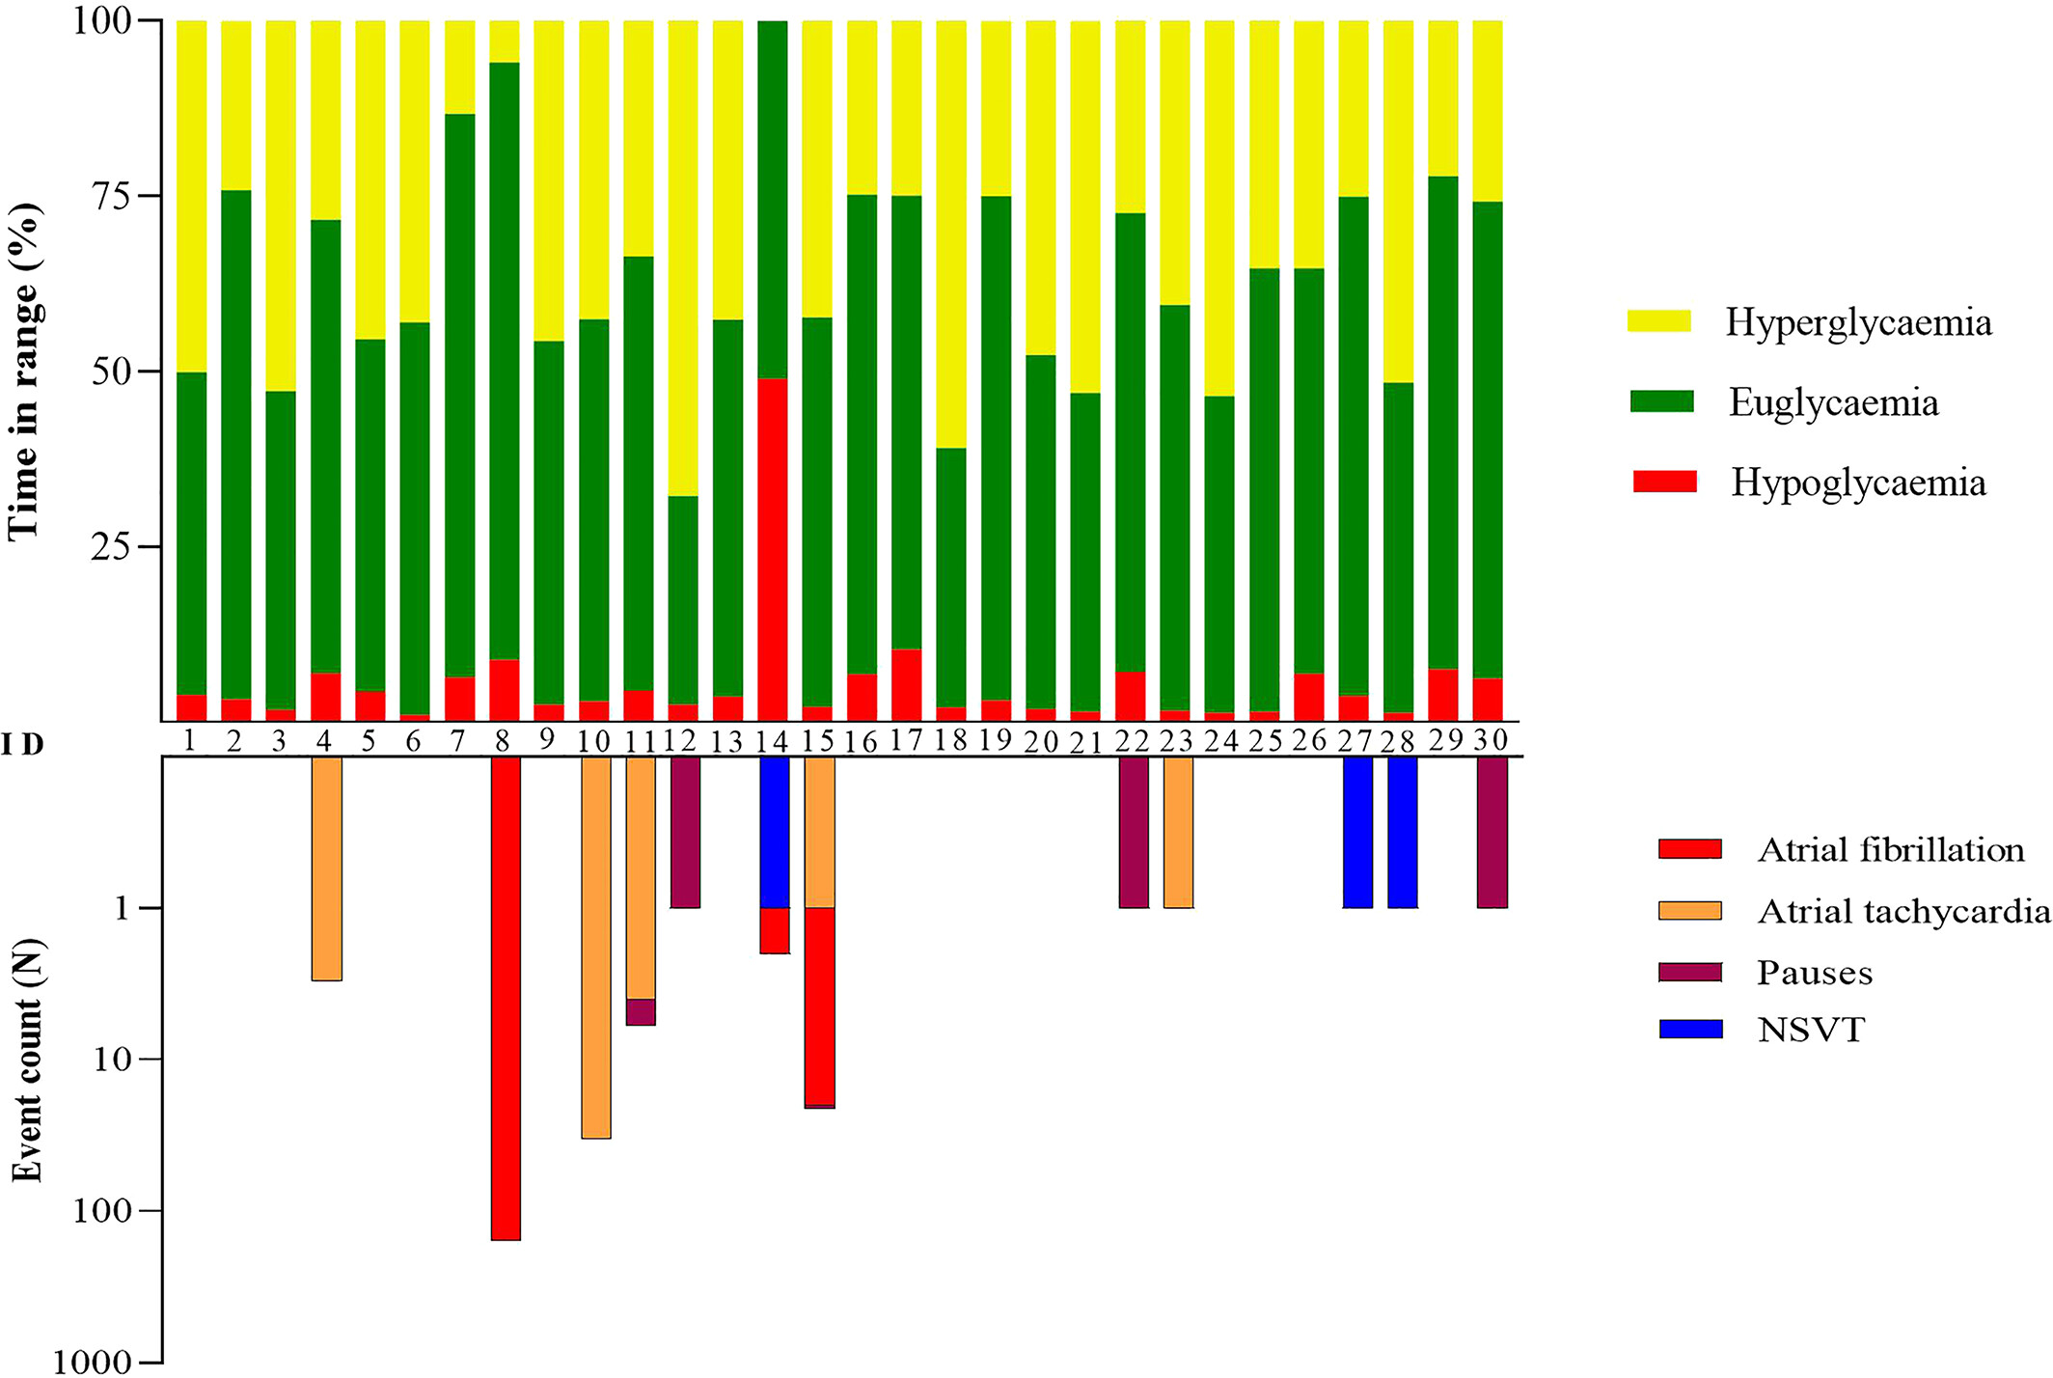
Diabetes Obesity Metabolism, Volume: 25, Issue: 8, Pages: 2300-2309, First published: 18 May 2023, DOI: (10.1111/dom.15108)
results

Slide 16
ASSOCIATION BETWEEN GLYCEMIC PROFIL AND CARDIAC ARYTHMIAS
Diabetes Obesity Metabolism, Volume: 25, Issue: 8, Pages: 2300-2309, First published: 18 May 2023, DOI: (10.1111/dom.15108)
results

Slide 17
ASSOCIATION BETWEEN GLYCEMIC PROFIL AND CARDIAC ARYTHMIAS
Diabetes Obesity Metabolism, Volume: 25, Issue: 8, Pages: 2300-2309, First published: 18 May 2023, DOI: (10.1111/dom.15108)
results

Slide 18
ASSOCIATION BETWEEN GLYCEMIC PROFIL AND CARDIAC ARYTHMIAS
Diabetes Obesity Metabolism, Volume: 25, Issue: 8, Pages: 2300-2309, First published: 18 May 2023, DOI: (10.1111/dom.15108)
results

Slide 19
ASSOCIATION BETWEEN GLYCEMIC PROFIL AND CARDIAC ARYTHMIAS
Diabetes Obesity Metabolism, Volume: 25, Issue: 8, Pages: 2300-2309, First published: 18 May 2023, DOI: (10.1111/dom.15108)
results

Slide 20
ASSOCIATION BETWEEN GLYCEMIC PROFIL AND CARDIAC ARYTHMIAS
Diabetes Obesity Metabolism, Volume: 25, Issue: 8, Pages: 2300-2309, First published: 18 May 2023, DOI: (10.1111/dom.15108)
results

Slide 21
ASSOCIATION BETWEEN GLYCEMIC PROFIL AND CARDIAC ARYTHMIAS
Diabetes Obesity Metabolism, Volume: 25, Issue: 8, Pages: 2300-2309, First published: 18 May 2023, DOI: (10.1111/dom.15108)
results

Slide 22
ASSOCIATION BETWEEN GLYCEMIC PROFIL AND CARDIAC ARYTHMIAS
Diabetes Obesity Metabolism, Volume: 25, Issue: 8, Pages: 2300-2309, First published: 18 May 2023, DOI: (10.1111/dom.15108)
results

Slide 23
ASSOCIATION BETWEEN GLYCEMIC PROFIL AND CARDIAC ARYTHMIAS
Diabetes Obesity Metabolism, Volume: 25, Issue: 8, Pages: 2300-2309, First published: 18 May 2023, DOI: (10.1111/dom.15108)
results

Slide 24
ASSOCIATION BETWEEN GLYCEMIC PROFIL AND CARDIAC ARYTHMIAS
Diabetes Obesity Metabolism, Volume: 25, Issue: 8, Pages: 2300-2309, First published: 18 May 2023, DOI: (10.1111/dom.15108)
results

Slide 25
Diabetes increases the risk of cardiac arrhythmia, particularly through QT prolongation and supraventricular and ventricular excitability disorders.
The occurrence and time spent in hyperglycemia during the day is associated with an increased risk of arrhythmias compared to euglycemia in T1D.
The risk of arrhythmia is much more related to the time spent in hypoglycemia and not to its occurrence in acute hypoglycemia!
CONCLUSION

Slide 26
There are diurnal and nocturnal differences in susceptibility to arrhythmia in diabetics ( no association between glycemic profile and arrhythmia during the night is found).
Glycemic variability increases the risk of arrhythmia in type 2 diabetics but not type 1 diabetics!
CONCLUSION

