Slide 1
New 2023 ACR/EULAR Classification Criteria for APS
Dr Bensefia Amel
Friday 8 december 2023

Slide 2
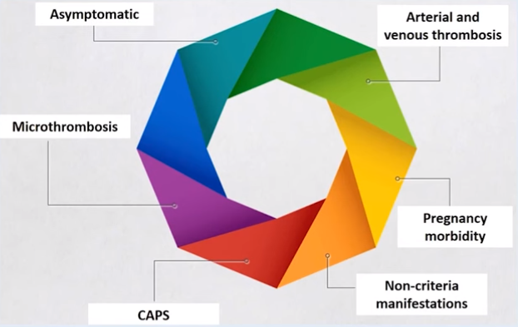

Slide 5
Antiphospholipid laboratory profile

Slide 6
« Provoked » or « unprovoked » thrombosis

Slide 7
1 vs several manifestations

Slide 10
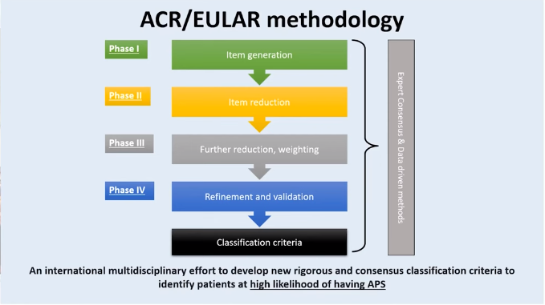

Slide 26
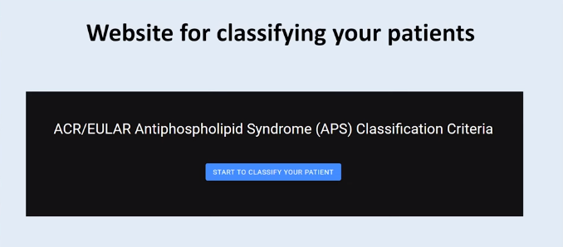

Slide 27
Conclusion
The aim of developing these new ACR/EULAR classification criteria for APS is to increase the specificity for identifying homogeneous groups of patients with a high probability of having APS.

